Slide 1
Professor Rury Holman University of Oxford, UK
Professor Chang Yu Pan Professor Da Yi Hu Chinese PLA General Hospital University of Peking China China

Slide 2
Rationale for ACE Trial
Accumulating evidence suggests a close association between “prediabetes” and cardiovascular disease (CVD)
Treating conventional risk factors in type 2 diabetes does not reduce CVD risk to the same level as in a non-diabetic population
Post-prandial hyperglycaemia may explain the excess risk seen in diabetes and “prediabetes”
Reducing post-prandial hyperglycaemia with acarbose has been reported¹ to reduce CVD risk in “prediabetes”.
However, the impact on new CVD events in individuals with existing CVD and “prediabetes” is unknown
1. Chiasson JL et al. JAMA 2003; 290(4): 486-94

Slide 3
ACE Study Design
ACE is an investigator designed trial
Multi-centre, randomised cardiovascular outcome trial in patients who have both cardiovascular disease and impaired glucose tolerance
Comparing the addition of double-blind acarbose or placebo to usual care
Independent academic data collection, analysis and reporting
Conducted in Mainland China and Hong Kong
Recruitment conducted in ~150 hospitals
Event driven

Slide 4
ACE Trial Management
Sponsor University of Oxford
Coordinating Centre Diabetes Trials Unit, Oxford Centre for Diabetes, Endocrinology & Metabolism
Regional Coordinating Centre ACE Chinese Project Office, OUBST, Beijing
Funding & Study Medication Bayer
…in an academic collaboration with

Slide 5
Major Inclusion Criteria
Male or female, aged 50 years or more
Cardiovascular disease (CVD)
Prior myocardial infarction
Prior unstable angina
Current stable angina
Impaired glucose tolerance (IGT) when screened with an oral glucose tolerance test:
Fasting plasma glucose <7.0 mmol/l
2-hour plasma glucose ≥7.8 and ≤11.1 mmol/l
Optimized CVD drug therapy with no planned revascularisation procedures
Written informed consent

Slide 6
Major Exclusion Criteria
History of diabetes (except gestational diabetes)
Myocardial infarction, unstable angina, stroke or TIA within the last 3 months
NYHA class III or IV heart failure
Severe hepatic disease
Severe renal impairment (eGFR <30 ml/min/1.73m²)
Gastrointestinal problems or alpha glucosidase inhibitor intolerance
Pregnancy or possibility of pregnancy
Thought by the investigator to be unsuitable

Slide 7
Sample Size Estimation
Assuming:
A 20% relative reduction for the primary cardiovascular endpoint, compared with placebo
Alpha of 5%
For 85% power the study requires
6,300 patients, i.e. 3,150 per group
A minimum of 728 adjudicated primary events
Recruiting a total of 6,500 patients will allow for a possible 3% loss-to-follow up

Slide 8
ACE Trial Intervention
In addition to usual care:
Randomised addition of
Acarbose, 50 mg three times daily or
Matching placebo, three times daily
Tablets will be taken with meals using a ‘Start low, go slow’ dose titration

Slide 9
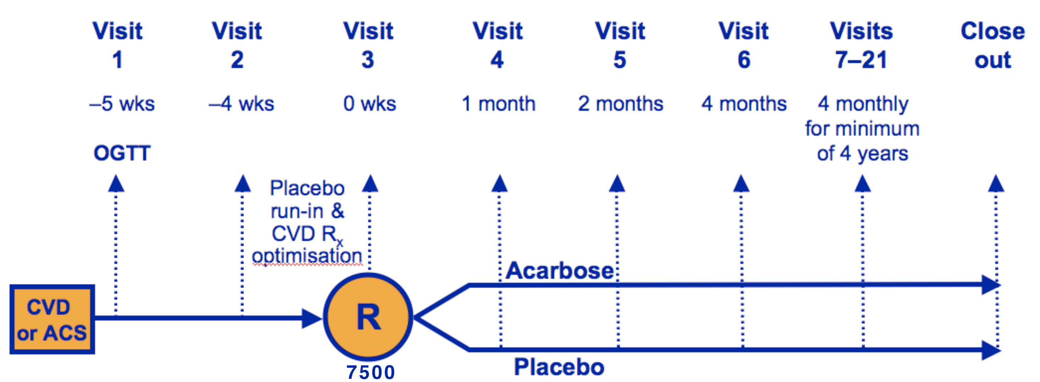
ACE Study Flow Chart
6500
A minimum of 728 adjudicated primary events are required

Slide 10
Cardiovascular Therapy Optimisation
Therapy for coronary heart disease (CHD) will be optimised during a four-week, single-blind, placebo run-in period
This is to ensure usual care therapy conforms to international guidelines for treating patients with established CHD
CHD therapy should include:
Antiplatelet therapy
A statin, unless contraindicated or not tolerated
ACE inhibitor, beta-blocker and/or antihypertensive therapy, if considered indicated by the investigator

Slide 11
ACE Trial Primary Endpoint
5-point MACE composite primary CVD outcome, defined as the time to the first occurrence after randomisation of any of the following:
Cardiovascular death
Nonfatal myocardial infarction
Nonfatal stroke
Hospitalisation for unstable angina
Hospitalisation for heart failure

Slide 12
ACE Trial Secondary Endpoints (1)
New-onset type 2 diabetes, confirmed by two successive diagnostic plasma glucose values of:
FPG ≥7.0 mmol/l (126 mg/dl) and/or
2HPG ≥11.1 mmol/l (200 mg/dl)

Slide 13
ACE Trial Secondary Endpoints (2)
All cause mortality
3-point MACE composite CV outcome:
Cardiovascular death
Nonfatal myocardial infarction
Nonfatal stroke
All MACE components will also be analysed individually

Slide 14
Other Outcomes
Impaired renal function (eGFR <60 ml/min/1.73 m²), or doubling of baseline creatinine
Quality of Life assessed by EQ 5-D questionnaire
Health Economic evaluation

Slide 15
Endpoint Adjudication
Two independent Endpoint Committees, masked to therapy allocation, adjudicate:
All potential cardiovascular endpoints
All instance of diabetes not diagnosed per protocol

Slide 16
Safety Monitoring
ACE is being conducted to ICH-GCP standards
Liver function is monitored annually by ALT levels
Reporting of SUSARs and AEs that are related to changes in Study Medication
Twice yearly review of unmasked safety data by an independent Data Safety Monitoring Board (DSMB)

Slide 17
ACE Steering Committee
Rury Holman UK Diabetologist
DaYi Hu China Cardiologist
ChangYu Pan China Diabetologist
Juliana Chan Hong Kong Diabetologist
Jean-Louis Chiasson Canada Diabetologist
Hertzel Gerstein Canada Diabetologist
WenYing Yang China Diabetologist
JunBo Ge China Cardiologist
Huo Yong China Cardiologist
John McMurray UK Cardiologist
Lars Ryden Sweden Cardiologist
Michal Tendera Poland Cardiologist
Jaakko Tuomilehto Finland Epidemiologist
DTU Head of Clinical Research
Bayer Project Manager (2)
Honoured Advisor
JiaLun Chen China Diabetologist

Slide 18
Milestones
ACE was launched in May 2008 at the South China International Cardiology Conference in Guangzhou
177 centres trained and activated
156 continue with follow-up
First patient randomised 17 Feb 2009
Recruitment completed 23 Oct 2015
6,526 participants randomised
Results expected in 2017

Slide 19
Publications
Rationale for and design of the Acarbose Cardiovascular Evaluation (ACE) trial. Rury R Holman, Mary A Bethel, Juliana CN Chan, Jean-Louis Chiasson, Zoë Doran, Junbo Ge, Hertzel Gerstein, Yong Huo, John J McMurray, Lars Ryden, Winitha Liyanage, Stefan Schröder, Michal Tendera, Michael J Theodorakis, Jaakko Tuomilehto, Wenying Yang, Dayi Hu, Changyu Pan for the ACE Study Group.
American Heart Journal 2014;168:23-29
Chinese Journal of Cardiology 2015;43:412 (Abstract)
Int J Endocrinol Metab. 2016 (Full text)

Slide 20
Thank you
www.dtu.ox.ac.uk/ACE

